Slide 1
AUTOMATION PARKING SYSTEM
Progress Report
Week 3
YOLO v5 · Numberplate Detection · ESP32-S3 · PostgreSQL

Slide 2


Progress – Week 2
AUTOMATION PARKING SYSTEM
01
02
Database
YOLOv5 Model Tuning
Build a database and test with PostgreSQL
Tune the YOLOv5 model achieving more accuracy and better multi-plate detection

Slide 3
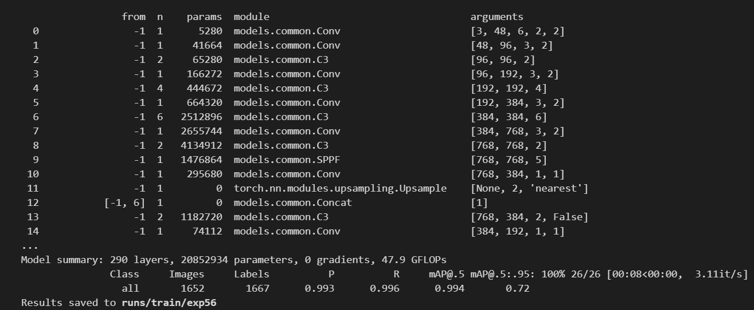
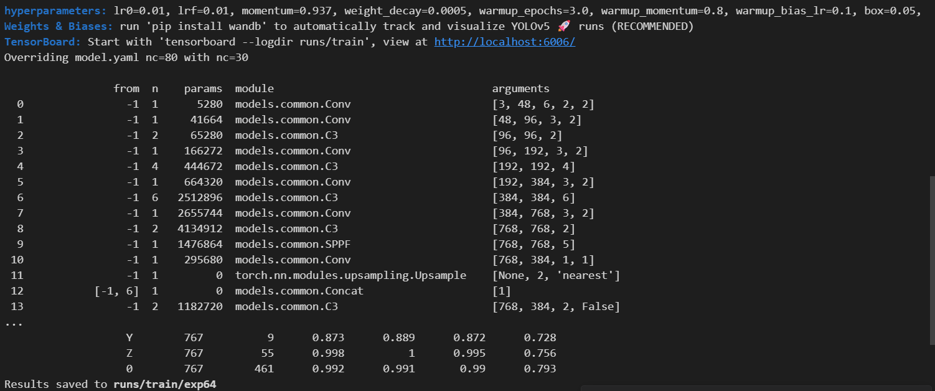
Model Tuning
01 / 02 · Progress – Week 3
Plate detection
Character detection

Slide 4
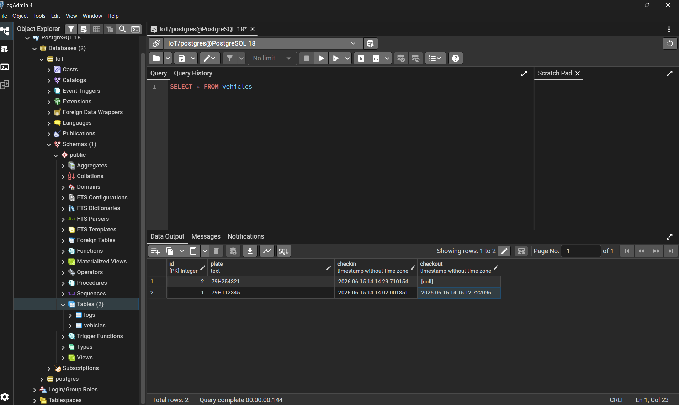
Database
02 / 02 · Progress – Week 3

Slide 5
Plans for Week 4
AUTOMATION PARKING SYSTEM · UPCOMING
01
02
03
Motion Sensor Firmware
Backend & Firmware Integration
Debugging & Stabilisation
Select & integrate motion sensor module with ESP32-S3
Connect firmware event pipeline to Python backend
Identify and fix timing/sync issues in firmware ↔ backend
Write firmware driver for motion detection events
Run tests with repeated detection cycles
Test sensor sensitivity and response timing
Review logs and validate data integrity in Database

Slide 6
Thanks for your listening
AUTOMATION PARKING SYSTEM · PROGRESS REPORT · WEEK 3

